Slide 1
The Driver Alabama Driver’s Manual Chapter 4
Personality
Concentration
And the impact they have on driving on driving

Slide 2
Personality
Problems that can distract a driver
The well-adjusted person as a driver
The effects driving has on a person

Slide 3
Distracted Drivers
Problems
Best Action?
Worried or Preoccupied
Home Troubles
Problems with friends
Serious illness in family
Frightened
Angry
Depressed
Let someone else drive
Take some time to cool off

Slide 4
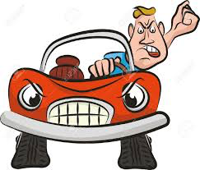
What Type of Person Are You?
Being behind the wheel of a car can reveal the type of personality you have.
Good
Bad
Reliable
Courteous
Sportsmanlike
Psychologically/Emotionally Mature
Bully
Lane-Stealer
Thoughtless Lawbreaker
Self-Centered

Slide 5
Concentration
One of the most important aspects of safe driving
A study, conducted by The institute for Road Safety Research (SWOV), shows of 69 crashes and 761 near crashes recorded roughly 78% happened without the driver seeing what was coming.
Driving is a full time job and requires full attention.
Don’t let “I don’t know what happened” be your excuse after an accident.

Slide 6
Cell Phones
What is the #1 responsibility when using cell phones while driving?
Driving!
Assess traffic Conditions
Use Speed dial when possible
Place calls when stopped or have a passenger call
Use speaker phone or hands free
Avoid intense calls or talking in congested traffic

Slide 7
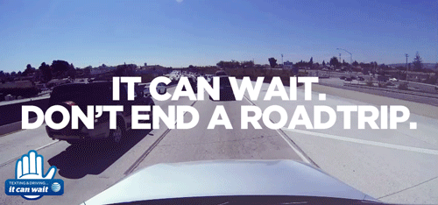
Texting While Driving
DON’T!!!
The National Safety Council reports that cell phone use while driving leads to 1.6 million crashes each year

Slide 8
Alabama Texting and Driving Law
Section 32-5A-350
(b) A person may not operate a motor vehicle on a public road, street, or highway in Alabama while using a wireless telecommunication device to write, send, or read a text-based communication.
Fines
- First violation $25
- Second violation $50
- Third violation $75
Law enfoncement officers may treat a violation of this section as the primary or sole reason for issuing a citation to a driver.

Slide 9
Highway Hypnosis
Drowsiness is one of greatest dangers in interstate driving
Highway Hypnosis is brought on by monotony
Take regular stops every 100 miles or every two hours
Keep your eyes moving to avoid this type of drowsiness

Slide 10
Distracted Driving Stats
49% of all fatal crashes in Alabama in 2014 occurred at night
A texting driver is 23 times more likely to get into a crash than a non texting driver
In a typical year in Alabama, about 27% of all crashes occur on rural two-lane roads
The Alabama Interstate represents only 1% of the state’s total mileage, but carries 25% of the traffic volume and is responsible for 11% of fatalaties

