Slide 1
The Dangers of Drinking and Driving
Roy Ryan
Dadeville H.S.

Slide 3
Penalty’s for Driving Under the Influence
First Conviction- Fine of $600-2,100 and Up to one year in Jail or Both And License suspended for 90 Days.
Second Conviction in 5 years-$1,100-5,100 jail for up to 1 year. A Mandatory 48 hours in jail and one year and revocation of your license.
3rd Conviction- fine $2,100-10,100 revoked license for 3 years. Mandatory-minimum 60 days in jail.
4th- conviction-Class C Felony! Fines from $4,100-10,000 five year revocation on the license. Additionally the offender can be jailed for not less than 1 year and 1 day to 10 years!

Slide 4
Effects of Alcohol on the body
Alcohol is a depressant.
Drowsiness, Blurred Vision, slowed reflexes
Affects judgement and coordination
Impairment can occur before legal intoxication is Attained.
Alcohol related crashes have killed more people than ALL the U.S. soldiers killed in war.

Slide 5
It is unlawful to operate a motor vehicle if you are…
A person under the influence of Drugs or Alcohol.
Over 21 with a BAC of .08 or higher
Under 21 with a BAC of .02 or higher.
Commercial vehicle operator whose BAC is .04 or higher
School bus Driver and Daycare Drivers whose BAC are .02 or higher.

Slide 6
What is implied Consent, and what does it mean?
Implied Consent- Any person who operates a motor vehicle on the public highways of the state of Alabama shall be deemed to have given his consent to a chemical test or tests of his or her Blood, Breath, or Urine to determine blood alcohol content.
If you Refuse to submit to a test by an officer you will have your license suspended for 90 days.

Slide 7
Facts to know about alcohol.
Alcohol is a depressant and slows normal reflexes.
It doesn’t matter what you drink ex: Beer, Wine, Whiskey- it’s the amount of alcohol which enters the blood that counts!
Only time will sober you up! Coffee Food, or a cold shower will not sober you up!
The liver oxidizes 1 drink per hour. So if you have 4 drinks in 2 hour’s you must wait at least 3 hour’s after you take your last drink before getting behind the wheel.

Slide 8
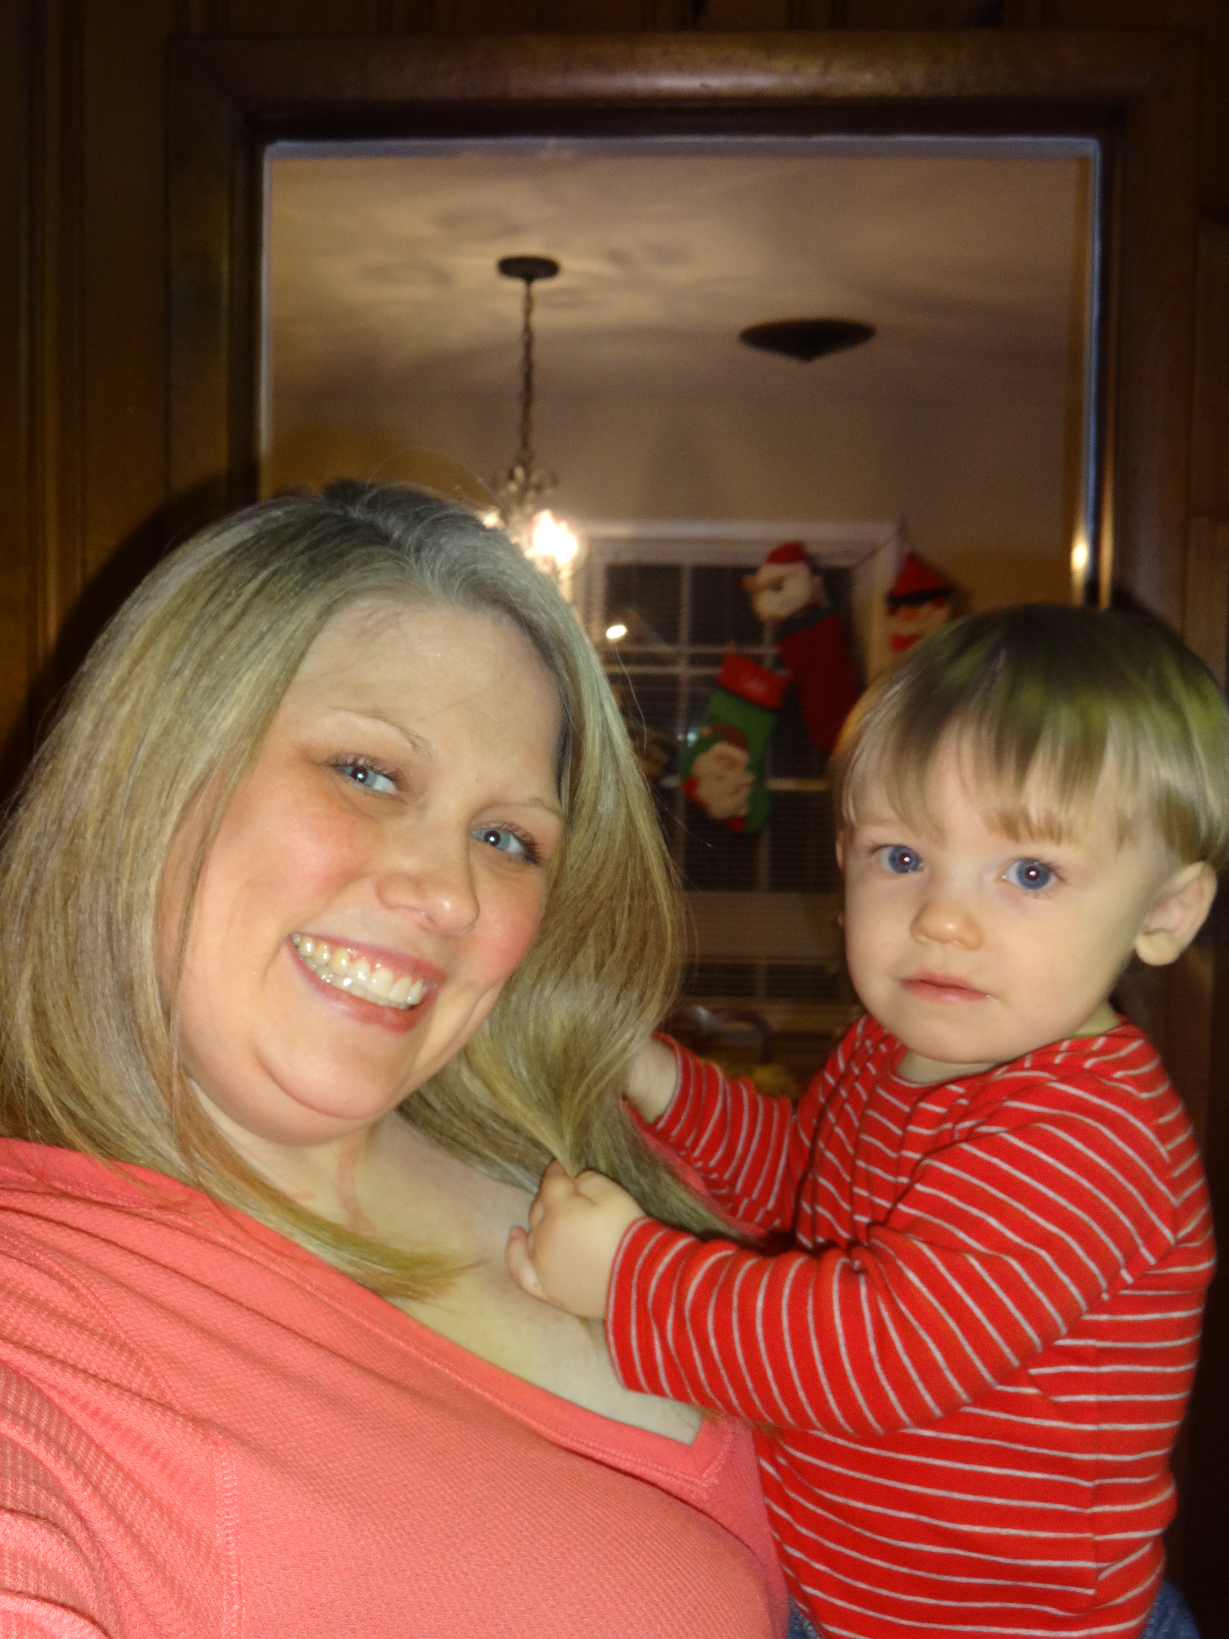
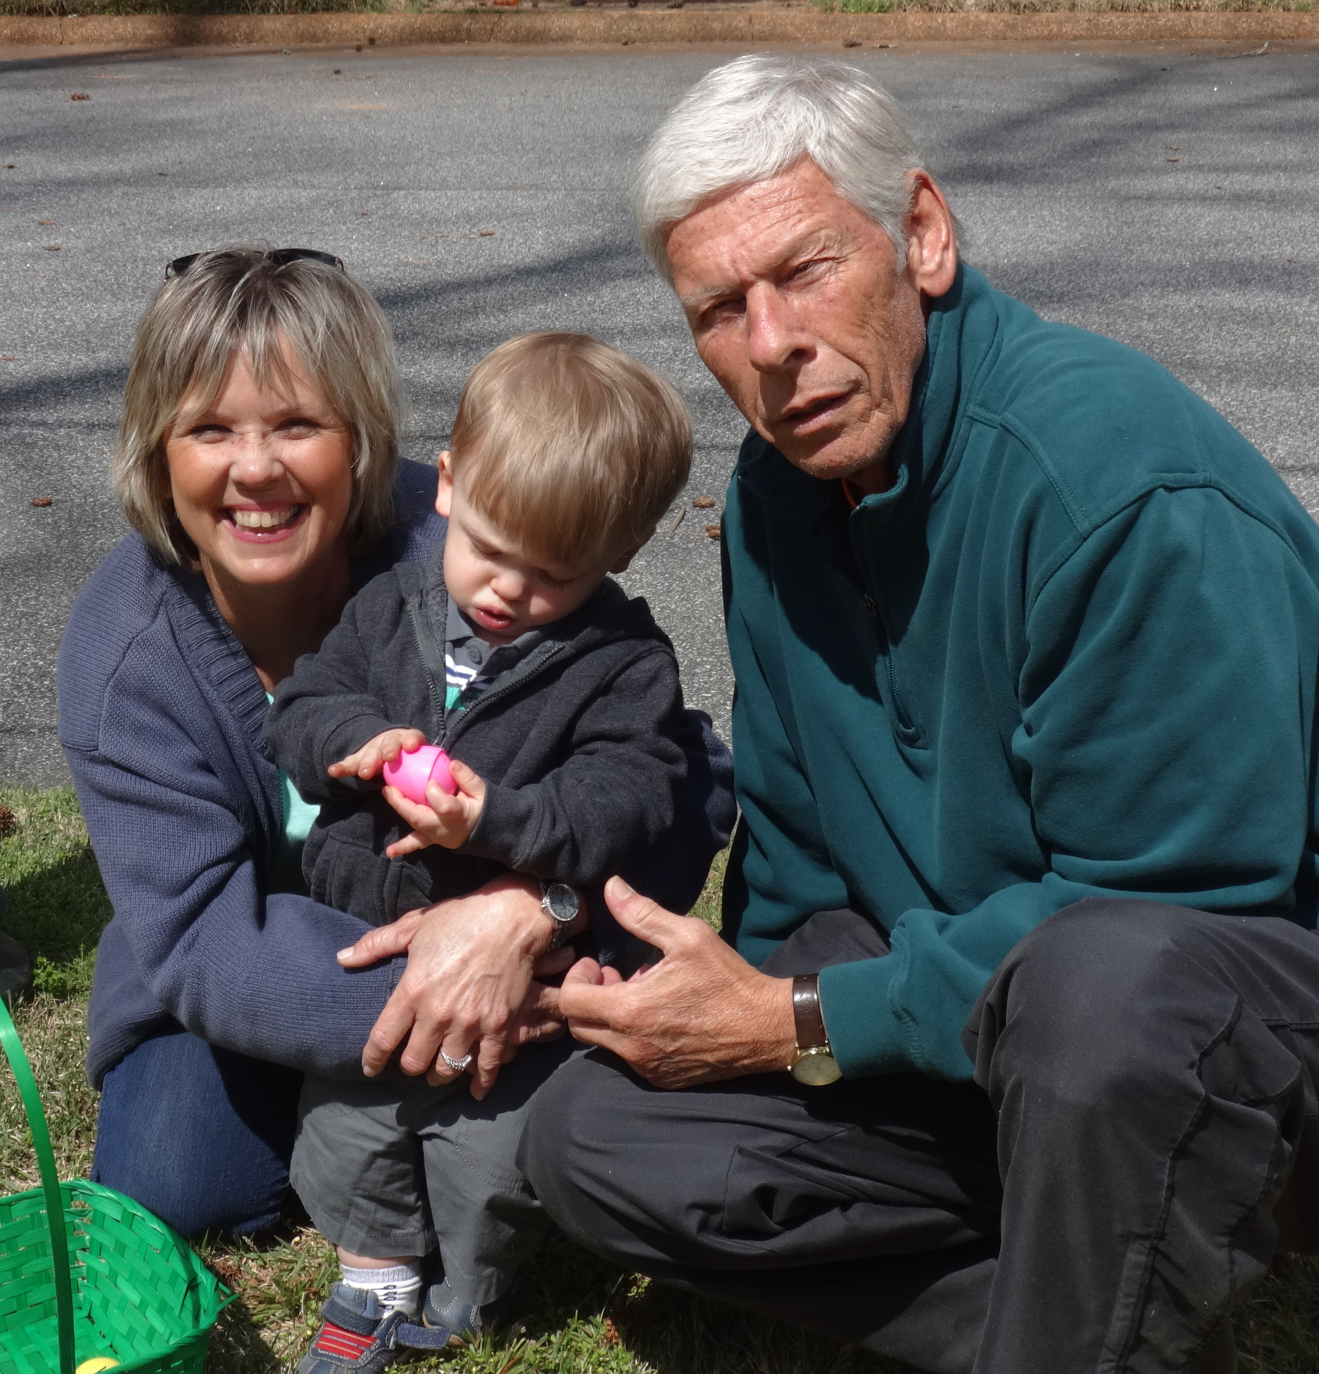
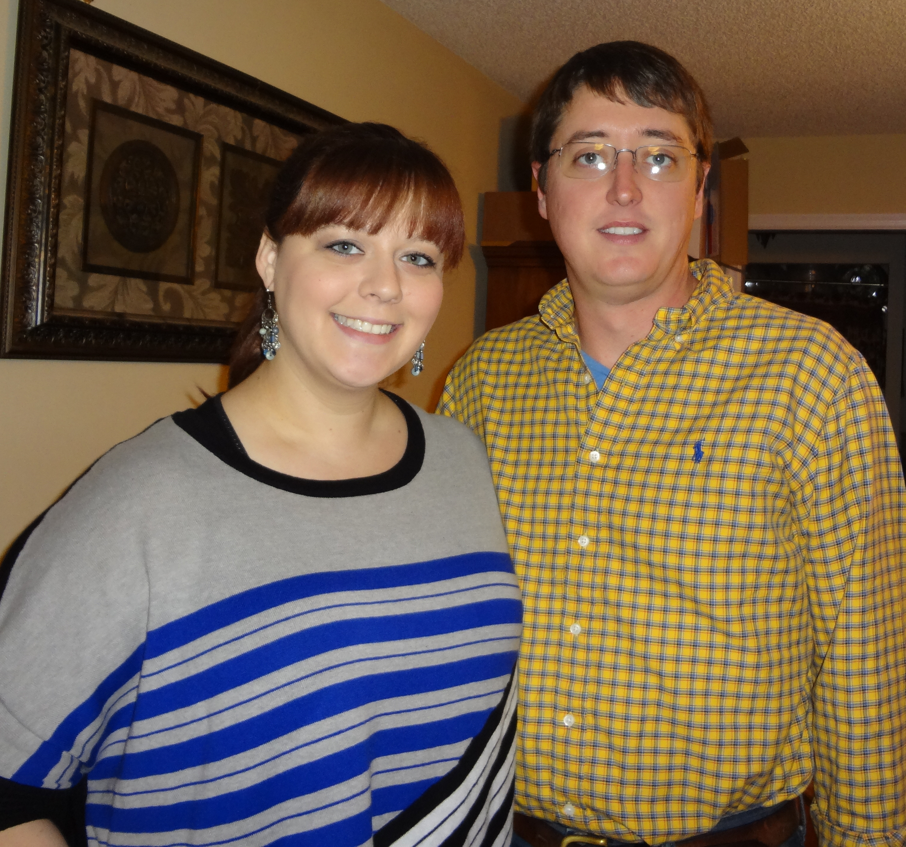
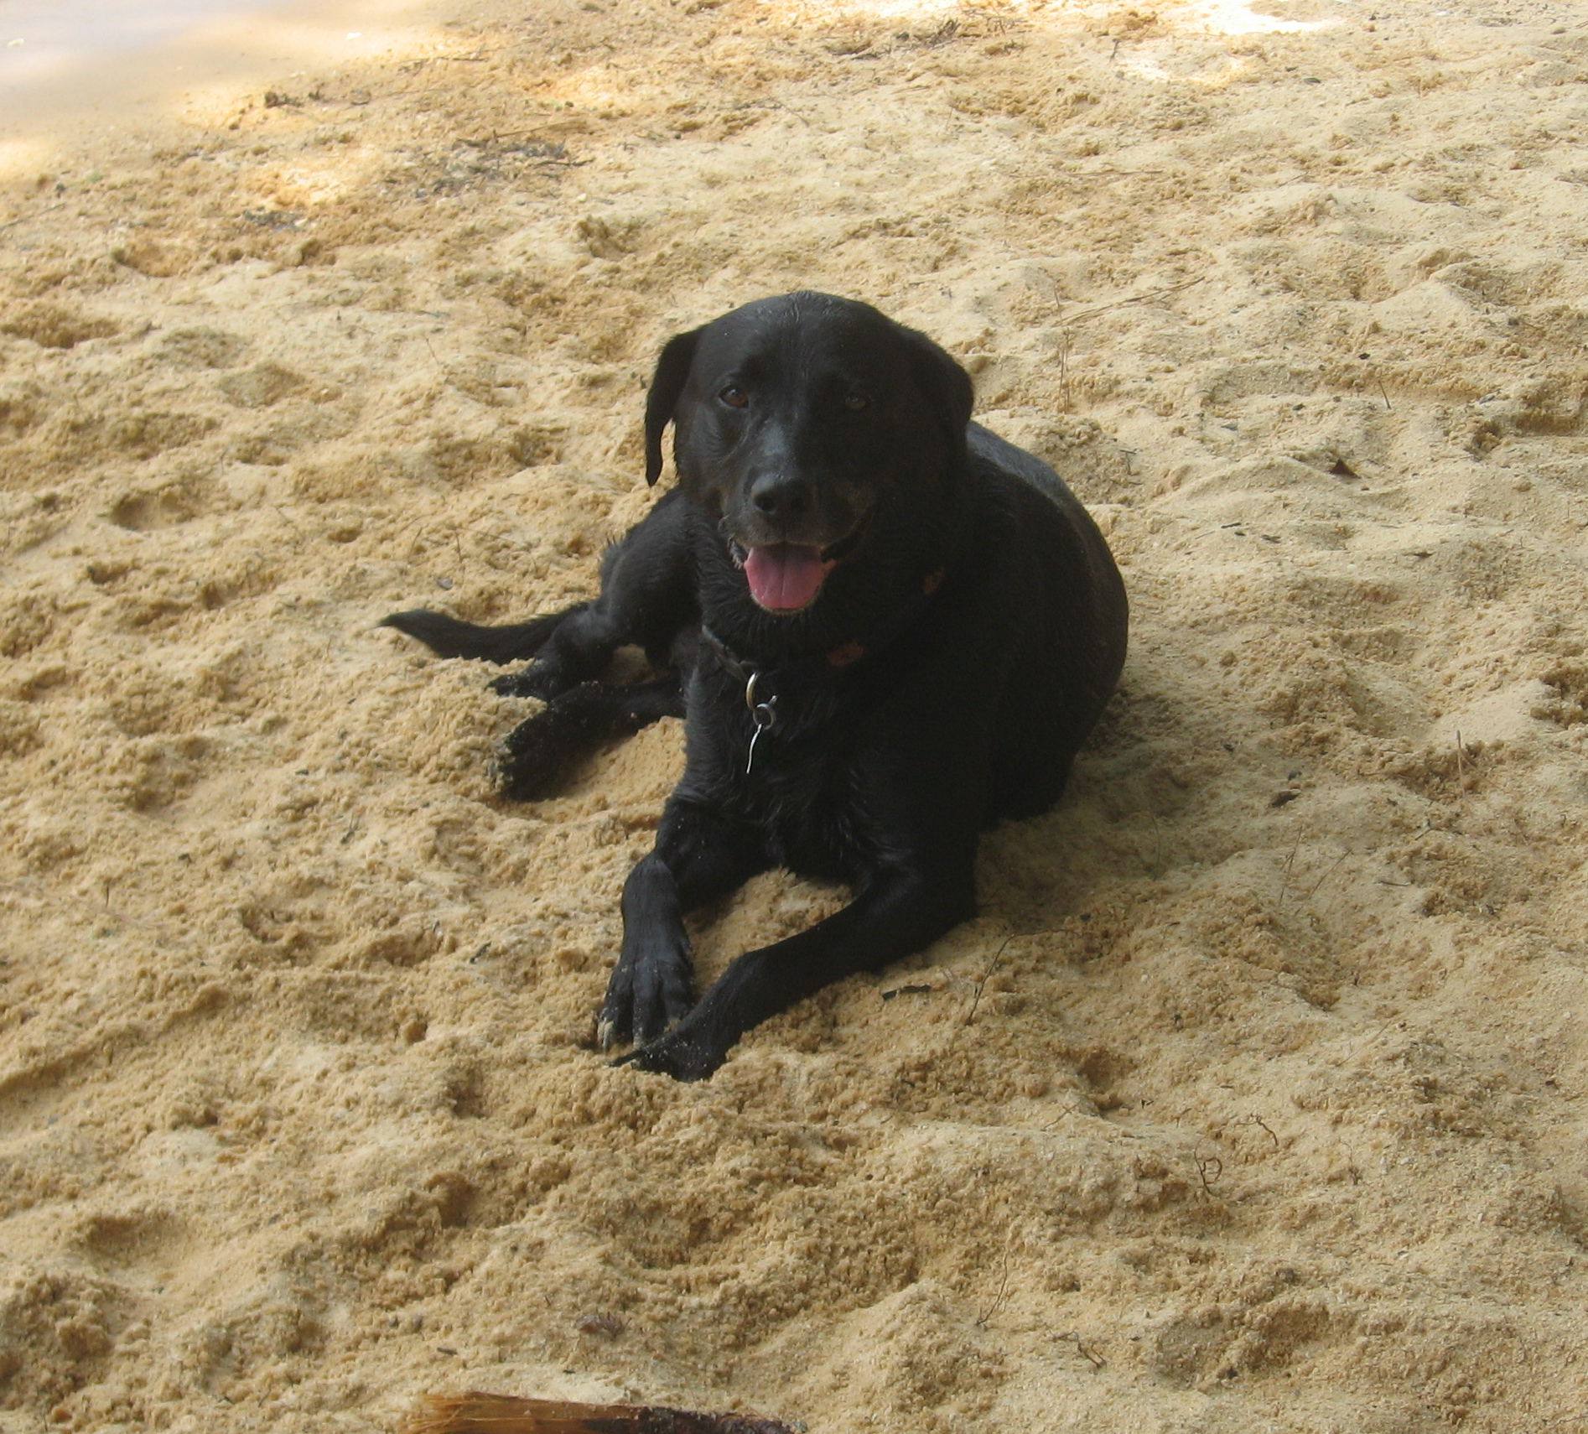
Reasons not to Drink and Drive:
Wife and Son
Mom and Dad
Friends
Pets

