Slide 1
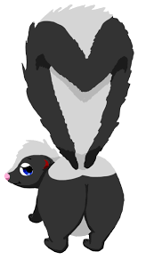
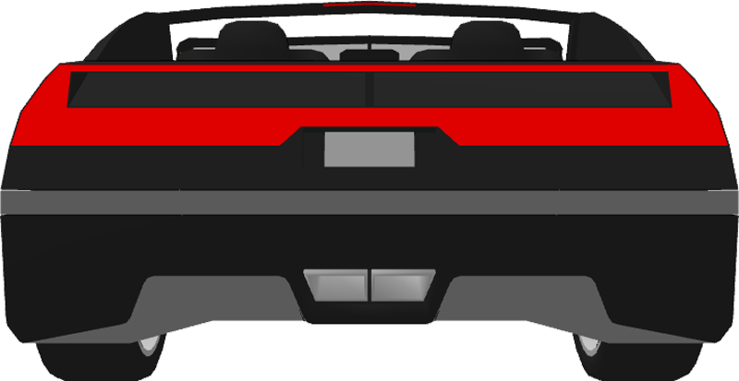
Without saying anything inappropriate, what do these images have in common?

Slide 2
How to avoid colliding into the rear end of a car.
Most caused by following too closely.
Following distance:
1. Cushion of space from the vehicle.
Factors:
1. speed of traffic
2. condition of the road
3. enough distance to stop safely.
2. Two Second Rule:
Helps to measure a safe distance from the car in front.
1st select a fixed object on the raod ahead.
When the vehicle ahead passes that object, begin to count “one thousand one, one thousand two. If you reach the object before one thousand two, you are too close.

Slide 3
TWO SECOND RULE
It applies in good or bad weather.
It road conditions are not favorable increase the count to 4 or 5 seconds.
Increase the distance if the vehicle is heavier, longer, or towing something.
If you see brake lights or the following distance lessens, shift your foot to the brake pedal promptly so you are ready to stop.

Slide 4
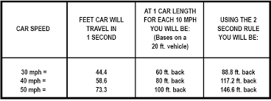
Two Second Rule

Slide 5
STOPPING DISTANCE
Factors
1. mental and physical reaction time of the driver.
2. Road condition: wet, rough, smooth, slippery etc.
3. type and condition of brakes and tires. (oversize- may make you hydroplane. narrow- cut through water but may skid more on a dry surface.)
4. size of vehicle
5. wind direction

Slide 6
WHAT TO DO IF YOU HAVE A CRASH
1. STOP
2. AID INJURED PERSONS (AVOID MOVING)
3. CALL FOR MEDICAL ASSISTANCE, IF NEEDED.
4. WARN TRAFFIC, IF THE POLICE AREN’T PRESENT.
IF THERE ARE NO INJURIES
1. GET ALL THE NAMES AND ADDRESS INVOLVED, INCLUDING WITNESSES.
2. MAKE SURE YOU HAVE AND GIVE YOUR INFORMATION TO THE OTHER PARTY. (NAME, ADDRESS, INSURANCE COVERAGE, AND NAME OF THE AGENT.
3. IF YOU CAN’T GET THEIR INSURANCE INFORMATION AT THE ACCIDENT, DO IT LATER. IT MAY BE BENEFICIAL TO TAKE A PICTURE OF THEIR LICENSE WITH YOUR PHONE.

Slide 7
STOPPING DISTANCE
MAKE SURE THAT YOU ALSO ALLOW AUTOMOBILES ENOUGH STOPPING DISTANCE. DO NOT CHANGE LANES INFRONT OF A LARGE VEHICLE WITHOUT GIVING THAT VEHICLE ENOUGH ROOM TO STOP BEHIND YOU. SEMI TRUCKS NEED MORE ROOM TO STOP THAN A CAR DOES.

Slide 8
UNATTENDED VEHICLE
EITHER NOTIFY THE POLICE AND OR TRY TO LOCATE THE OWNER.
IF YOU CAN’T FIND THE OWNER, LEAVE YOUR INFORMATION IN CONSPICUOUS PLACE ON THE VEHICLE.
YOU MAY ALSO WANT TO TAKE A PICTURE OF THE CAR AND LICENSE PLATE WITH YOUR PHONE FOR EVIDENCE. THIS MAY HELP YOU IF THE OWNER TRIES TO CLAME THAT YOU DID MORE DAMAGE TO THE CAR THAN WHAT ACTUALLY HAPPENED.

Slide 9
REPORTS HELP THE TRAFFIC OFFICIALS EVALUATE ACCIDENTS SO THEY CAN IMPROVE TRAFFIC CONDITIONS.

Slide 10
ALWAYS EXPECT A TRAIN

Slide 11
RAILROAD CROSSINGS

Slide 12
Railroad Crossing Safety Tip
Expect a train on any track at anytime. It takes a train going 55mph the length of 18 football fields to stop.
Never get trapped on a crossing. Stop 15 to 50 feet in front of the track.
Watch out for a second train. Do not proceed until you are sure it is clear.
Never drive around gates.
Never race a train. You can win or lose the automobile wins. If tie the train wins.
Watch out for vehicles that must stop at crossings. (Ex. School buses, church buses, and trucks transporting flammable or hazardous materials)
If your vehicle stalls on the track, get out immediately and call 911.

Slide 13
Map of Highway 31 Montgomery
https://www.google.com/maps/@32.3943229,-86.3952417,620m/data=!3m1!1e3
2.4 miles long
9 railroad crossings

