Slide 1
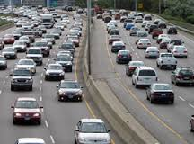
Driving the Freeways
Chapter 8
Alabama Department of Public Safety Driver Manual

Slide 2
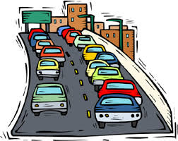
Freeways
Multi-lane
Controlled access
Divided highways that allow you to drive long distances without interruption
There are no stops and cross traffic
Allows you to arrive sooner and safely

Slide 3
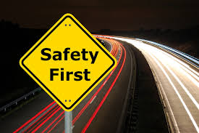
Staying Safe
Keep pace
Signal well in advance when changing lanes
Park entirely off highway when you have emergencies
Give distress signals
Open trunk
Raise hood
White cloth on antenna
Dial *HP or (*47) on cell phone

Slide 5
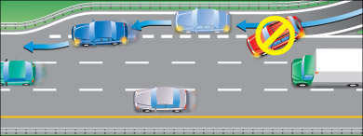
Entering the Freeway
Entrance ramps- short, one-way ramps that permit safe and easy entry.
Acceleration lane- a lane used to increase speed to match that of vehicles in the through lanes.
Watch for an opening
Activate turn signal
Merge smoothly
DO NOT come to full stop in the acceleration lane unless absolutely necessary

Slide 6
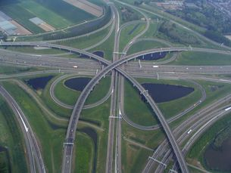
4 Types of Interchanges
Directional
Cloverleaf
Diamond
Trumpet

Slide 7
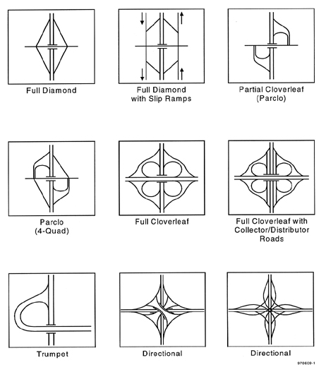

Slide 8
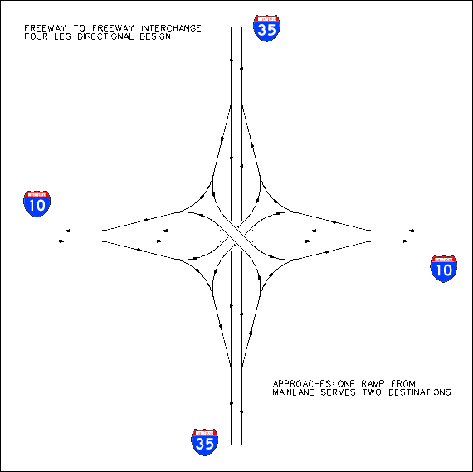
Directional Interchange
Is used where a high volume of traffic desires to transfer between only two legs of the interchange.
Designed to accommodate high volumes of traffic from west to north

Slide 9
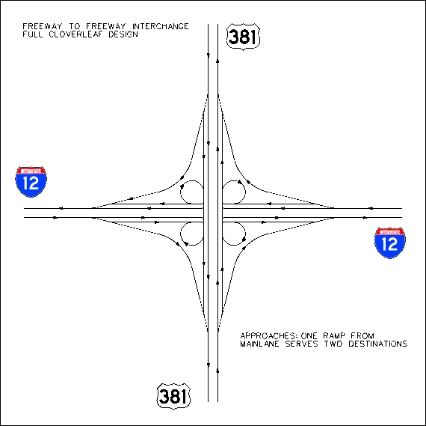
Cloverleaf interchange
Designed to allow turning movements off or onto the freeway from 4 directions
It eliminates left turn and cross traffic conflicts for all movements

Slide 10
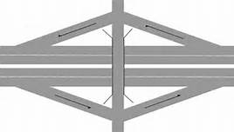
Diamond interchange
Characterized by 4 ramps
Allows vehicles to enter or exit the main highway while flowing with traffic
Left turns are made AFTER leaving the freeway

Slide 11
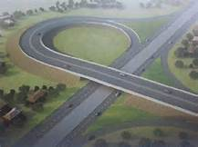
Trumpet interchange
Provides access to a freeway when another roadway connects
It’s a variation of directional or diamond type interchanges to permit turning movements on and off the highway.

Slide 12
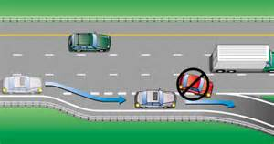
Leaving the Freeway
Have a plan in advance
Closely observe all signs
Move into proper lane well in advance
Signal your turn
Move into deceleration lane and reduce speed
Prepare to yield or stop when you come to the intersecting roadway

Slide 13
Freeway Nevers
Never reduce speed suddenly
Never back up
Never attempt to turn-around
Never stop
If you miss your exit, proceed to the next exit and come back to the one you missed.

